Slide 1
Title: Analysis of Movie Success Based on Various Variables
Presenter: Trevor Ouma
Date: 27/07/2024
Email: trevorouma7@gmail.com
LinkedIn: Trevor Ouma

Slide 2
Project overview
Introduction
Understanding what makes films successful at the box office. This analysis will provide insights to guide our film creation strategy.

Slide 3
SCOPE
Ratings: Correlation with other success metrics
Budget: Impact on financial performance
Gross Earnings: Domestic vs. worldwide
Director's Influence: Effect on movie success

Slide 4
Agenda
Business Understanding: Identifying the core business problem and objectives.
Data Understanding: Overview of the dataset and key metrics analyzed.
Data Analysis: Detailed examination of correlations and A/B testing results.
Recommendations: Actionable insights based on the analysis.
Next Steps: Suggested actions and further areas of investigation.

Slide 5
Data Understanding
Description of the Dataset
Columns: 18 attributes, including movie reviews, ratings, genre, director, and financial metrics.
Key Attributes and Metrics
Ratings: Impact on movie success.
Budget: Production costs.
Gross Earnings: Domestic and worldwide box office revenues.
Additional Attributes: Genre, director, release dates.

Slide 6
Source of the Data
The dataset was collected from
Box Office MojoLinks to an external site.
IMDBLinks to an external site.
Rotten TomatoesLinks to an external site.
TheMovieDBLinks to an external site.
The NumbersLinks to an external site.

Slide 7
Visual Analysis
Scatter Plots:Displayed relationships between:
Rating and Production Budget
Rating and Domestic Gross
Rating and Worldwide Gross
Production Budget and Domestic Gross
Production Budget and Worldwide Gross
Domestic Gross and Worldwide Gross
Regression Analysis:
Methodology:
Used linear regression models to predict domestic and worldwide gross based on production budget and director information.
Variables:
Predictors (Independent Variables): Production budget, one-hot encoded director information.
Targets (Dependent Variables): Domestic gross, worldwide gross.

Slide 8
Cont
Directors' Influence:Certain directors significantly influence the financial performance of movies.

Slide 9
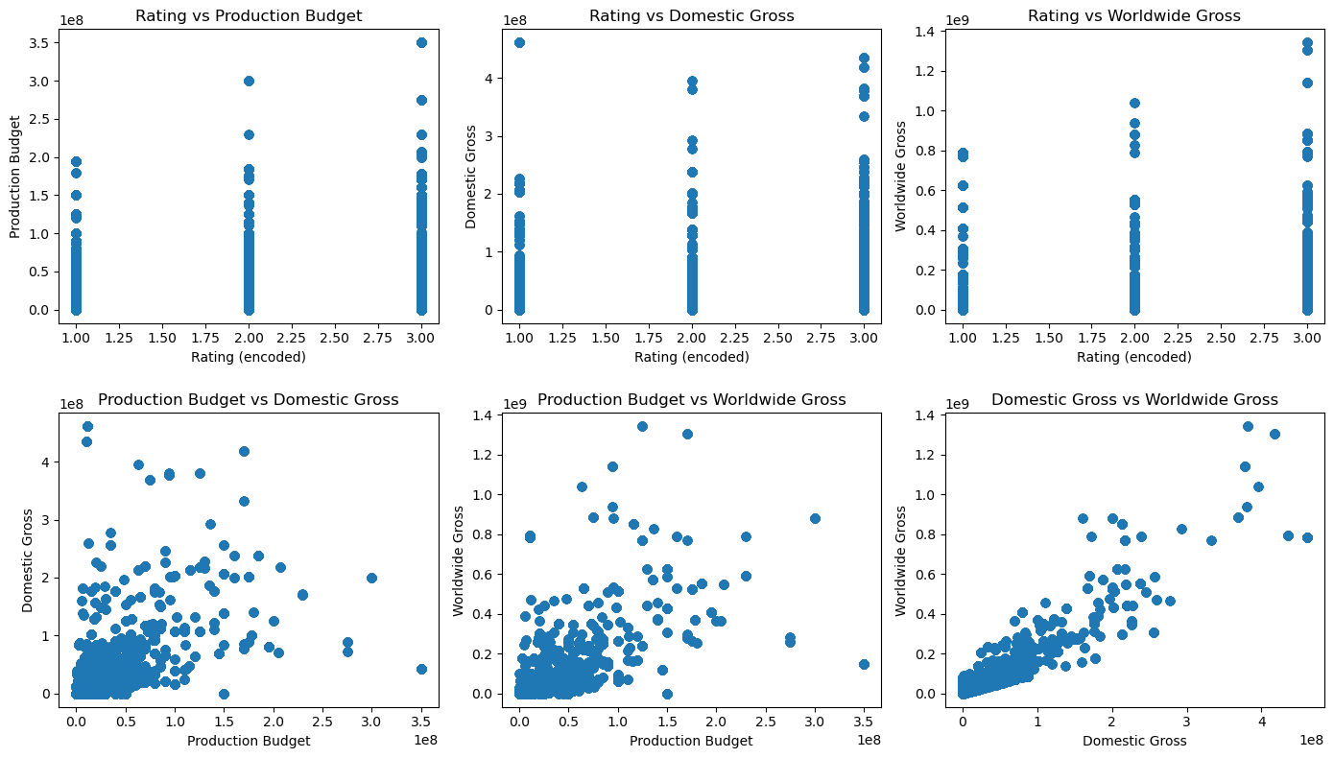

Slide 10
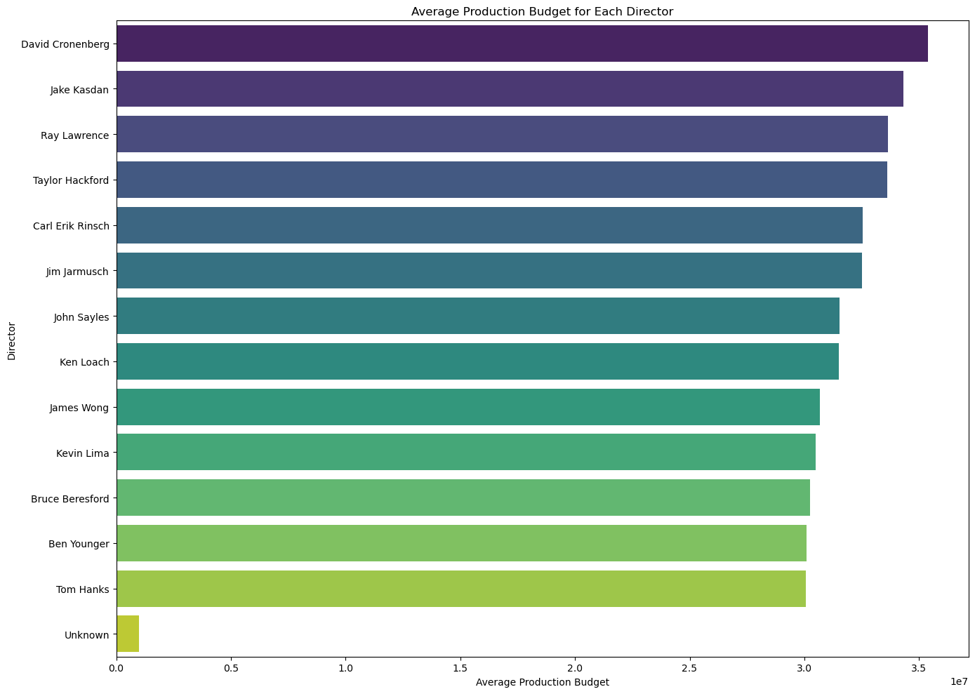

Slide 11
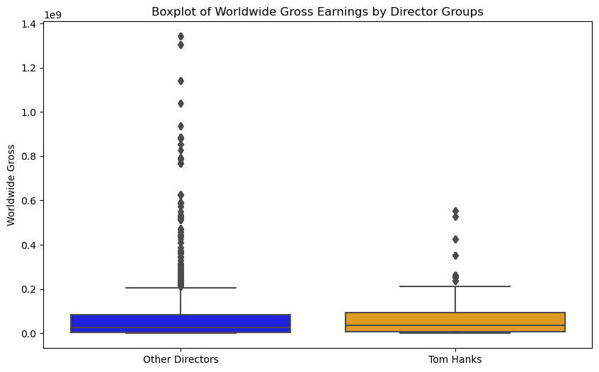

Slide 12
Recommendations
1.Invest in Renowned Directors
Actionable Recommendation: Focus on hiring directors with a proven track record to maximize domestic and worldwide gross earnings.
Explanation: The analysis shows that certain directors significantly boost both domestic and worldwide gross earnings, indicating their strong influence on a movie's financial success.

Slide 13
Cont.
2. Optimize Production Budget Allocation
Actionable Recommendation: Allocate higher budgets to projects with strong expected returns, but be mindful of diminishing returns.
Explanation: There is a clear positive correlation between production budget and gross earnings, but the returns diminish as the budget increases. Strategic allocation can optimize financial performance.

Slide 14
Cont.
3. Leverage Movie Ratings for Marketing and Budget Decisions
Actionable Recommendation: Use movie ratings to guide marketing efforts and budget allocations.
Explanation: Higher ratings correlate with higher gross earnings. Target marketing campaigns to emphasize high-rated aspects and allocate budgets accordingly to capitalize on this relationship.

Slide 15
Further Analysis
Investigate Marketing Spend: Analyze the impact of marketing expenditures on gross earnings to optimize marketing budgets.
Explore Genre Impact: Assess how different genres perform financially to guide genre selection for future projects.
Release Timing Analysis: Examine the effect of release dates and seasons on movie success to strategically plan release schedules.

Slide 16
Deeper Investigation Areas:
Audience Demographics: Study the impact of target audience demographics on movie success.
Competition Analysis: Evaluate the performance of movies released in the same period to understand competitive dynamics.
Streaming Platforms: Analyze the financial impact of movies released on streaming platforms versus traditional theaters.

Slide 17
Thank You
QUESTIONS?????

